Slide 1
Fraud detection with Graph Attention Networks
- By Sing Kwan NG and Anthony TAING
Notes:
Hello, I am Rohith Yamsani. we are a group of 2 people. I did this project along with sachin. We did a project called Fraud detection with Graph Attention Networks by Sing Kwan NG and Anthony TAING.

Slide 2
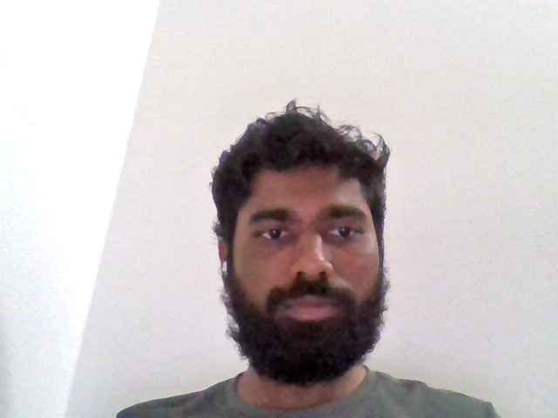
Introduction
Fraud Detection: It is a set of procedures and analysis that allow organizations to identify and prevent unauthorized financial activity
These activities include cyber hacking, insurance scams, fraudulent credit card transactions, identify theft and many more
Most of the traditional Machine learning fail to detect a fraud because of the complex network structure that these frauds use.
Graph Machine learning handles many complex issues and improves the accuracy of fraud predictions by using more relevant features information from the network.

Slide 3
Dataset:
For this project, we are using the Bitcoin dataset which maps Bitcoin transactions to real entities belonging to 2 different categories i.e., licit or illicit transactions.
Dataset is available in Kaggle.
Dataset is composed of three csv files.
The first file maps nodes according to their label (licit/illicit/unknown), the second introduces the edges between 2 nodes by using their "Ids," and the final file has nodes ids with 166 features.

Slide 4
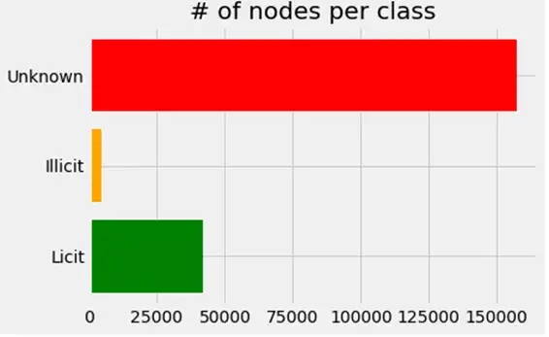
Dataset:
The graph contains 203,769 nodes and 234,355 edges, with 2% (4,545) of the nodes classified as class 1 (illicit) and 21% (42,019) as class 2 nodes, respectively (licit)
A node represents a transaction in the graph, an edge represents a movement of bitcoins between transactions.
Each node contains 166 features and has been classified as a "licit," "illicit," or "unknown" objects.

Slide 5
Data transformations
We are joining the Feature and Classes data frames
Changing the classes from name to integers in the classes file.
We created three different inputs to create a PyG dataset i.e., edge index, node features and edge weights.
We did data preprocessing for the node feature by removing unnecessary columns like transaction IDs and classes.
We then used the previously initialized node features, edge index, weights, and labels to transform the data to PyGeometric graph data format.

Slide 6
Graph Attention Networks (GATs)
Graph Neural Networks(GNN) are neural networks that provide an easy way to do node-level, edge-level, and graph-level prediction tasks.
Graph Attention Networks (GATs) are one of the most popular GNN architectures that performs better than other models.
We will use the Pytorch Geometric(PyG), which is the most popular graph deep learning framework.
PyG is useful for fast implementing GNN models because it already has a large number of graph models established for a variety of applications involving structured data.

Slide 7
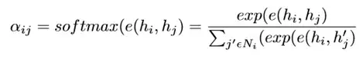
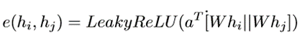
GAT v1
Any node in a GAT model that attends to its neighbors changes its representation by utilizing its own representation as the query.
As a result, each node calculates a weighted average of its neighbors and then chooses those that are most relevant to it.
This model uses an attention mechanism α(ij) to assess the significance of each message sent by various nodes in the neighborhood.
We can calculate attention score between two neighbors by a scoring function e

Slide 8
Coding GAT with PyG : Message Passing
Using PyG, we can create a simplified form of a GAT layer.
PyG provides the MessagePassing base class, which helps in creating message passing graph neural networks by automatically taking care of message propagation.
By using the message() function, you can specify what node information we want to pass for each edge.
With the help of the aggregate() function, we can specify how we want to combine the messages coming from all edges to the destination node (e.g., "add," "mean," "max," etc.).
The propagate() function enables us to do message aggregation and passing over each edge and node in the graph.

Slide 9
Model Training
For model training and evaluation, a trainer and metric manager classes are created
The GNNtrainer helps to run the training epochs. we also added helper functions to make training and testing easier.
With the help of MetricManager all the necessary metrics are calculated at each epoch.
The metric manager has an in built function to help calculate the best results for the entire run.

Slide 10
GAT v2
With the help of GAT v2, we can calculate dynamic attention which overcomes the GAT model's prior drawback.
Every query has a different ranking of attention coefficients of the keys.
The GATv2 model performs better than the previous version of GAT as it uses a dynamic graph attention variant.
Dynamic graph attention variant has a universal approximator attention function
Since dynamic attention can "concentrate" on the most relevant information, it offers a considerably stronger robustness to noise.

Slide 11
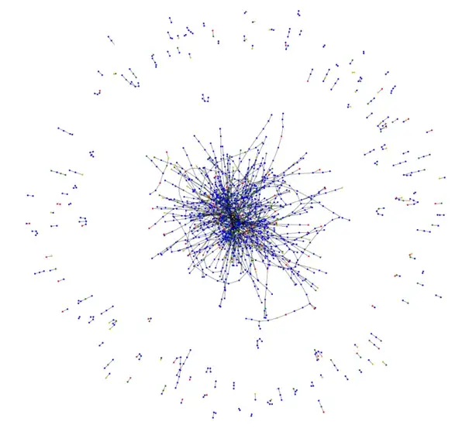
Visualization:
Green = Not illicit (not fraud)
Red = illicit (Fraud)
Blue = Predicted not illicit
Orange = Predicted illicit
Majority of transactions nodes are heavily linked in a cluster.
The actual fraud and the predicted fraud from the new model are fairly distributed among the central cluster and the shorter transaction chains.

Slide 12
Conclusion:
Graph Attention Network assigns varied priorities to nodes in the same neighborhood to increase the model's capacity, while still working on all of the neighboring nodes.
On the fraud dataset, both of the prebuilt GAT models perform very well, achieving 0.92 F1 macro and 0.97 accuracy.
The GATv2 model should be used as a standard instead of the original GAT model because it performs better than GAT on several benchmarks.

Slide 13
Thank You
Team Members:
Rohith Yamsani, ID: 6364594
Sachin Sravan Kumar Komati, ID: 6384991

